Slide 1

EFFECT OF THE PLATFORM ON RATINGS

Slide 2
INPUT DATA
1. The data-sets have been loaded into Python using read_csv( ) method and pandas:
Google=pd.read_csv('C:\\Users\\User\\KUGLE\\googleplaystore.csv')
Apple=pd.read_csv('C:\\Users\\User\\KUGLE\\Applestore.csv')
2. For the purpose of further evaluation the following columns were picked:
for Google: 'Category', 'Rating', 'Reviews', 'Price'
for Apple: 'prime_genre', 'user_rating', 'rating_count_tot', 'price'

Slide 3
CLEANING-TRANSFORMING-VISUALIZING
Checked the data types for both Google and Apple and fixed them.
array([ 0. , 4.99, 3.99, 6.99, 1.49, 2.99, 7.99, 5.99,
3.49, 1.99, 9.99, 7.49, 0.99, 9. , 5.49, 10. ,
24.99, 11.99, 79.99, 16.99, 14.99, 1. , 29.99, 12.99,
2.49, 10.99, 1.5 , 19.99, 15.99, 33.99, 74.99, 39.99,
3.95, 4.49, 1.7 , 8.99, 2. , 3.88, 25.99, 399.99,
17.99, 400. , 3.02, 1.76, 4.84, 4.77, 1.61, 2.5 ,
1.59, 6.49, 1.29, 5. , 13.99, 299.99, 379.99, 37.99,
18.99, 389.99, 19.9 , 8.49, 1.75, 14. , 4.85, 46.99,
109.99, 154.99, 3.08, 2.59, 4.8 , 1.96, 19.4 , 3.9 ,
4.59, 15.46, 3.04, 4.29, 2.6 , 3.28, 4.6 , 28.99,
2.95, 2.9 , 1.97, 200. , 89.99, 2.56, 30.99, 3.61,
394.99, 1.26, 1.2 , 1.04])

Slide 4
Add a `platform` column to both the `Apple` and the `Google` data frames
Category Rating Reviews Price platform
0 ART_AND_DESIGN 4.1 159 0.0 google
1 ART_AND_DESIGN 3.9 967 0.0 google
2 ART_AND_DESIGN 4.7 87510 0.0 google
3 ART_AND_DESIGN 4.5 215644 0.0 google
4 ART_AND_DESIGN 4.3 967 0.0 google

Slide 5
Category Rating Reviews Price platform
0 Games 4.0 21292 3.99 apple
1 Productivity 4.0 161065 0.00 apple
2 Weather 3.5 188583 0.00 apple
3 Shopping 4.0 262241 0.00 apple
4 Reference 4.5 985920 0.00 apple

Slide 6
Create a New Joint Table by Joining the Two Data Sets: Apple and Google df=pd.concat([df1,df2], ignore_index=True) df.sample(12)
Category Rating Reviews Price platform
7769 FAMILY 4.3 13 0.00 google
4058 PERSONALIZATION 4.5 10158 0.00 google
7975 PERSONALIZATION 3.2 114 0.00 google
17059 Games 3.5 163 0.00 apple
5962 FAMILY 4.4 21 0.00 google
5537 HOUSE_AND_HOME 4.6 353813 0.00 google
907 ENTERTAINMENT 4.2 2442 0.00 google
5048 TOOLS 2.0 2221 0.00 google
15971 Sports 0.0 0 0.99 apple
5093 TOOLS NaN 1 0.00 google
11656 Photo & Video 2.0 102 0.00 apple
8721 FAMILY 4.2 1661 9.99 google

Slide 7
Joint Table After the Elimination of the `NaN` Values, Filtering Only Those Apps That Have Been Reviewed At Least Once, and Summarizing the Data Visually and Analytically (by the Column `platform`)
Category Rating Reviews Price platform
0 ART_AND_DESIGN 4.1 159 0.00 google
1 ART_AND_DESIGN 3.9 967 0.00 google
2 ART_AND_DESIGN 4.7 87510 0.00 google
3 ART_AND_DESIGN 4.5 215644 0.00 google
4 ART_AND_DESIGN 4.3 967 0.00 google
... ... ... ... ... ...
18032 Games 4.5 142 0.00 apple
18033 Games 4.5 30 0.00 apple
18034 Utilities 4.5 15 1.99 apple
18035 Games 4.5 85 0.00 apple
18036 Games 5.0 3 0.00 apple

Slide 8
The means of the Rating for the items in the Category column are calculated (see the Table below) and presented in the form of a boxplot (see the next slide).
count mean std min 25% 50% 75% max
platform
apple 6268.0 4.049697 0.726943 1.0 4.0 4.5 4.5 5.0
google 9366.0 4.191757 0.515219 1.0 4.0 4.3 4.5 5.0
The observed difference between the means of the Ratings between Google and Apple platforms is 4, 191757-4.049697=014206
Question: is this difference random or the result of the effect of the platform?.

Slide 9
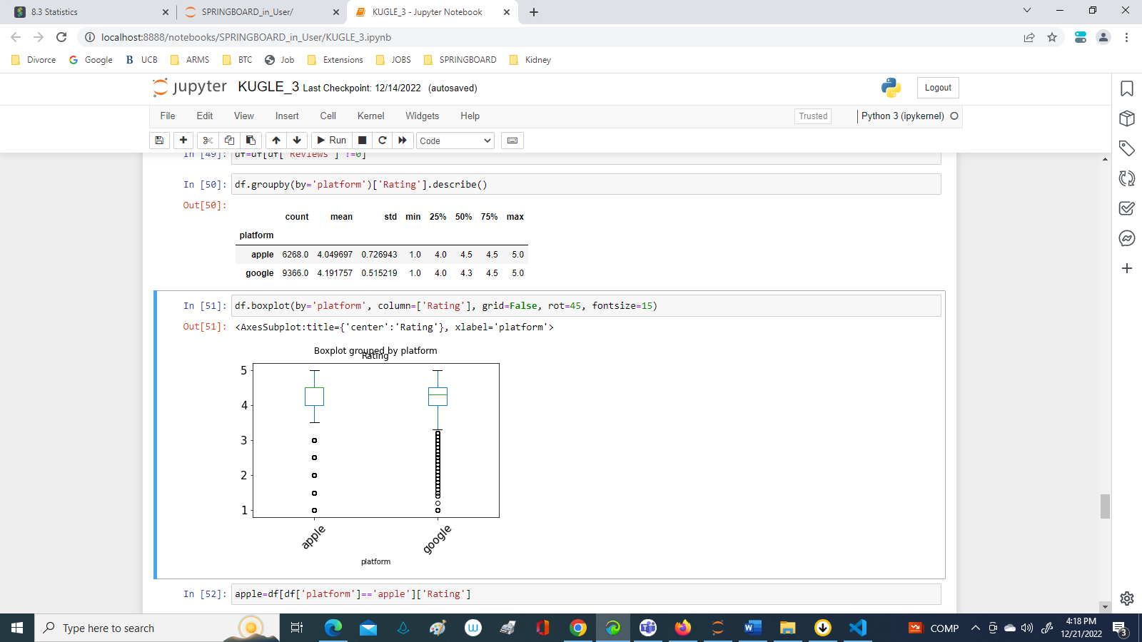
THE BOX PLOT

Slide 10
HYPOTHESES
Null hypothesis: the observed difference in the mean rating of Apple Store and Google Play apps is due to chance (and thus not due to the platform).
Alternate hypothesis: the observed difference in the average ratings of apple and google users is not due to chance, but, rather due to the platform
Choose the significance level: 0.05. Our judgement will be based on the distribution of the data test
Create a subset of the column 'Rating' by the different platforms:
apple = df[df['platform'] == 'apple']['Rating']
google=df[df[‘platform’]==’google’][‘Rating’]

Slide 11
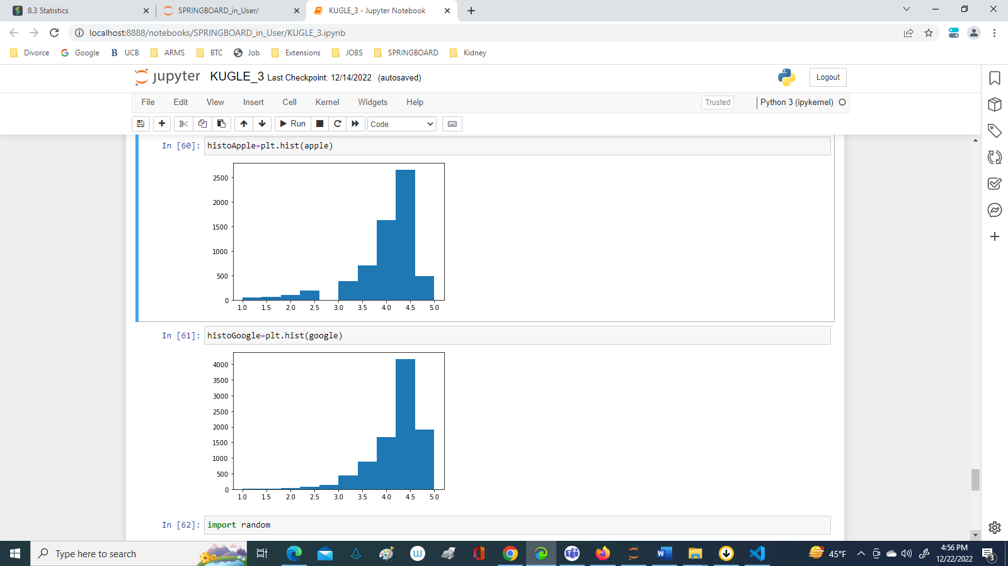
Determine if the apple and google data are normally distributed by using stats.normaltest() method.
The results of the tests are the following:
Apple NormaltestResult(statistic=1778.9974234584017, pvalue=0.0)
Google NormaltestResult(statistic=3678.6157187516856, pvalue=0.0)
Since p-values are zeros for both tests, the data is not normally distributed, this conclusion is supported by the Histograms.

Slide 12
PERMUTATION (SHUFFLE) TEST
Our Shuffle Test will be done on a table which has only 2 columns: ‘Rating’ and ‘platform’. All google and all apple platforms will be allocated to 18036 trials, any one of which could equally well have been chosen.
We created a column called `Permutation1`, and assigned to it the result of permuting (shuffling) the Rating column:
df['Permutation1']=np.random.permutation(df['Rating'])
df.groupby(by='platform')['Permutation1'].describe()
count mean std min 25% 50% 75% max
platform
apple 6268.0 4.134174 0.612697 1.0 4.0 4.3 4.5 5.0
google 9366.0 4.135223 0.613156 1.0 4.0 4.3 4.5 5.0
Lets compare these results with the previous analytical summary: the difference of the means is 4.135223-4.134174=0.001049. This difference of the means for Permutatation1 looks hugely different to our observed difference of 0.14206.
df.groupby(by='platform')['Rating'].describe()
Let's create 10,000 permutations, calculate the mean ratings for Google and Apple apps and the difference between these for each one permutation, and then take the average of all of these differences.

Slide 13
The Results of the 10000 Permutations
Platform count mean std min 25% 50% 75% max
apple 6268.0 4.132546 0.608957 1.0 4.0 4.3 4.5 5.0
google 9366.0 4.136312 0.615641 1.0 4.0 4.3 4.5 5.0
After 10000 permutations the difference of the means 4.136312-4.132546=0.003766

Slide 14
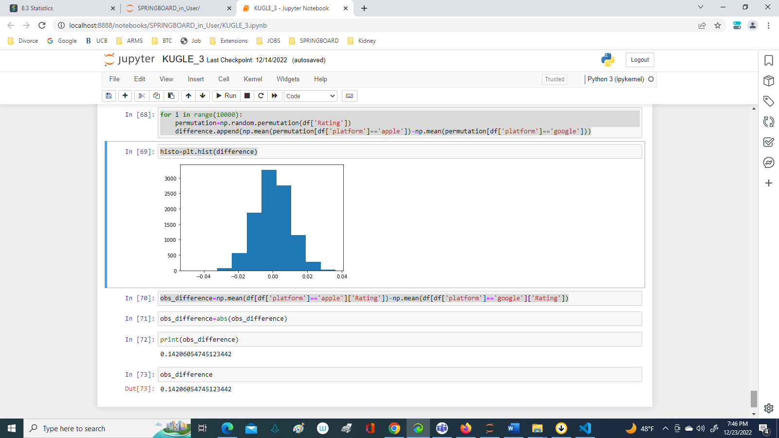
Let's create a distribution of the differences for Permutation1- that will be the distribution of the Null:
for i in range(10000):
permutation=np.random.permutation(df['Rating'])
difference.append(np.mean(permutation[df['platform']=='apple'])-np.mean(permutation[df['platform']=='google’]))
Next we calculated observed difference as:
obs_difference=np.mean(df[df['platform']=='apple']['Rating'])-np.mean(df[df['platform']=='google']['Rating'])
The value of the observed difference is 0.14206054745123442
Compare this number to the difference of the means for Permutation1: 0.003766!

Slide 15
CONCLUSION
The difference in the means for Permutation1 (0.003766) now looks hugely different to our observed difference of 0.14206. The number 0.003766 is the result of randomization, the number 0.14204 is x37 greater, hence we have serious doubts that this number is the result of randomization
It appears that our observed difference is significant, and that the Null Hypothesis is false; platform does impact on ratings

